Slide 1

Trees
CISC 610
Data Structures & Algorithms
Brian Grey

Slide 2
What are we doing today?
Trees
Terminology and Definitions
Creating Nodes and Generic Trees
Binary Trees
General Structure
Traversal Algorithms
Uses
Binary Search Trees (BST’s)

Slide 3
What is a tree?
Definitions:
A non-linear, hierarchical data structure
An acyclic graph
This thing:
Entertainment
Podcasts
TV
Movies
RadioLab
M*A*S*H
Schitt’s Creek
Captain America
First Avenger
Winter Soldier

Slide 4
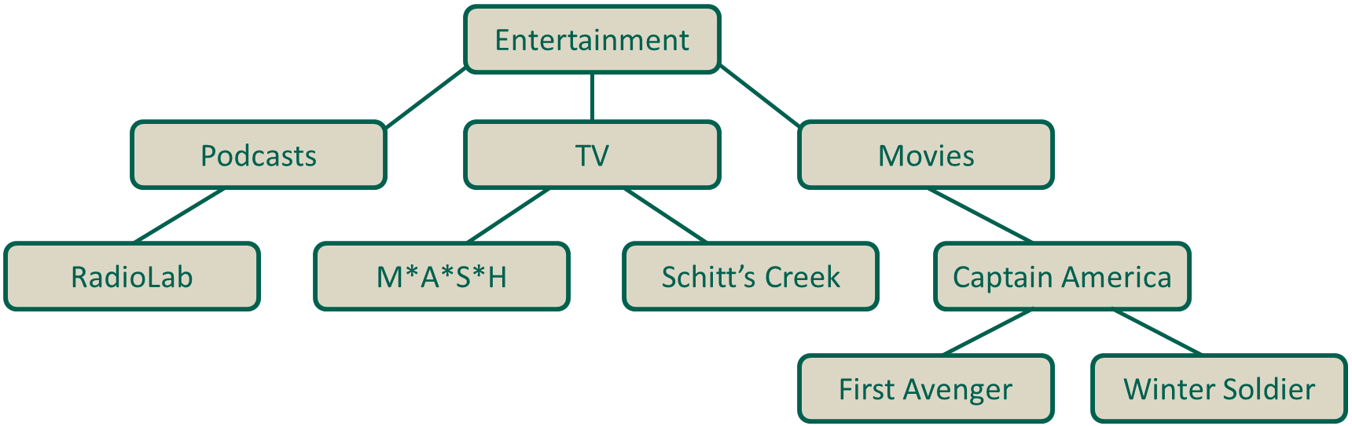
Definitions & Terminology
Definitions:
Node
An element in the tree
Edge
A connection between two nodes showing a parent/child relationship
Root
Node with no parents. Ancestor node of ALL other nodes
Leaf
Node with no children

Slide 5
Definitions & Terminology
Definitions:
Degree
The number of children a node has
Siblings
All nodes with the same parent node
Sub-tree
The tree created from a node and all of its descendants
Path
A sequence of nodes to get from one node to another

Slide 6
Definitions & Terminology
Definitions:
Level/Depth
How far into a tree a node is
How many edges you need to traverse to reach the node
Root is at level/depth of 0, its children level/depth of 1, etc.
Height
The number of nodes in the longest path from the root to a leaf
Multiple paths may fulfill this requirement

Slide 7

What is a Tree Node?
Similar to a node in a linked list
Contains link (reference) to data
Contains links to other nodes it is connected to
Child node(s)
Parent node?
If we were to implement it in Python:
Many algorithms/applications work best with a specific tree type

Slide 8
Binary Trees
Tree where each node contains no more than two children
Children are labeled left and right child
Complete
Every level is completely filled except for (possibly) the last
If the last level is not completely filled, it is filled from left to right
Full/Proper Binary Tree
Node has 0 or 2 children (Every parent has 2 children)

Slide 9
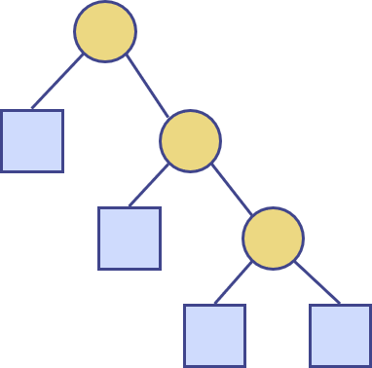
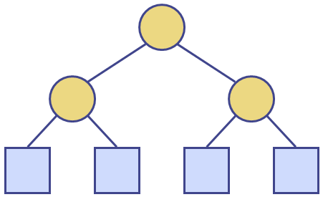

Properties of Full/Proper Binary Trees
Given $n$ nodes, $e$ leaf nodes, $i$ internal/non-leaf nodes, and a height of $h$, full binary trees have the following properties:
$e=i+1$
$n=2e−1$
$h≤i$
$h≤\frac{n−1}{2}$
$e≤2^{h}$
$h≥\log_{2}{e}$
$h≥(\log_{2}{(n+1))−1}$

Slide 10
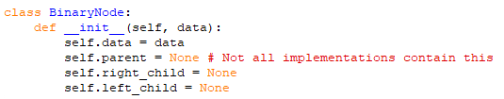
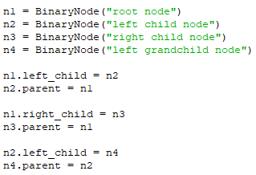
Building Binary Trees
First, we need to alter our node:
Then we can construct nodes and assemble our tree:

Slide 11
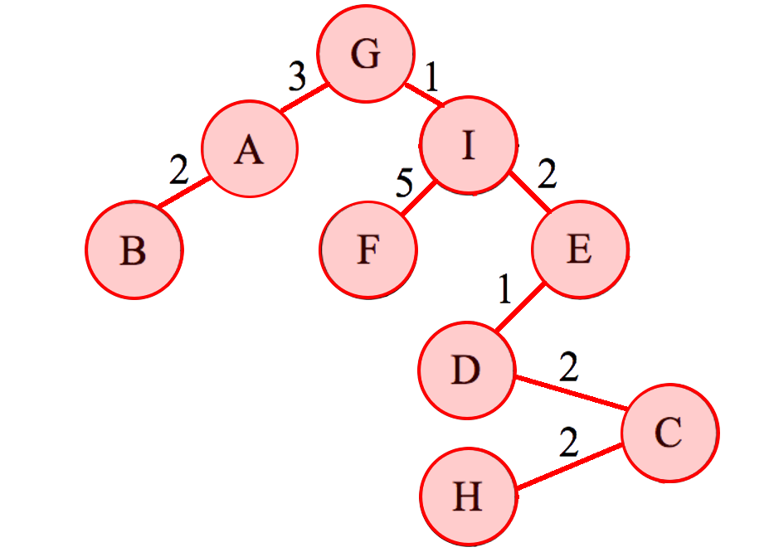
Breadth-First Traversal/Search
Iterating over a list is easy. Trees are trickier.
Breadth-first traversal examines all nodes at a level before moving to the next level using the algorithm:
Add the root to a FIFO queue
While the desired element has not been found and there are still elements in the queue
Dequeue a node
If the node doesn’t have the desired element
Add the current node’s children to the queue

Slide 12

Breadth-First Traversal/Search Performance
Analysis
Efficiency:
$O(\left|E\right|+\left|V\right|)$
Remember $O(\left|E\right|)$ can be between $O(1)$ and $O\left({\left|V\right|}^{2}\right)$
Memory intensive
Weak for deep nodes on wide trees

Slide 13
Depth-First Traversal/Search
Depth-first traversal considers a path all the way to a leaf node before considering a new path using the algorithm:
[Add the root to the list of visited nodes]
For all children of the current node
[If child hasn’t been visited,] recursively visit the left children
[If child hasn’t been visited,] recursively visit the right children
When is the current node checked?
Depends on the type of DFS

Slide 14
Depth-First Traversal/Search
Pre-order DFS
Check current node before visiting any children
“The first time you see it” in a binary tree
In-order DFS
Check current node after visiting left but before right children
“The second time you see it” in a binary tree
Post-order DFS
Check current node after visiting all children
“The third time you see it” in a binary tree
Portioning rules for “left vs. right” children affect non-binary trees

Slide 15

Depth-First Traversal/Search Performance
Analysis
Efficiency:
$O(\left|E\right|+\left|V\right|)$
Memory efficient
Weak for wide nodes on deep trees

Slide 16
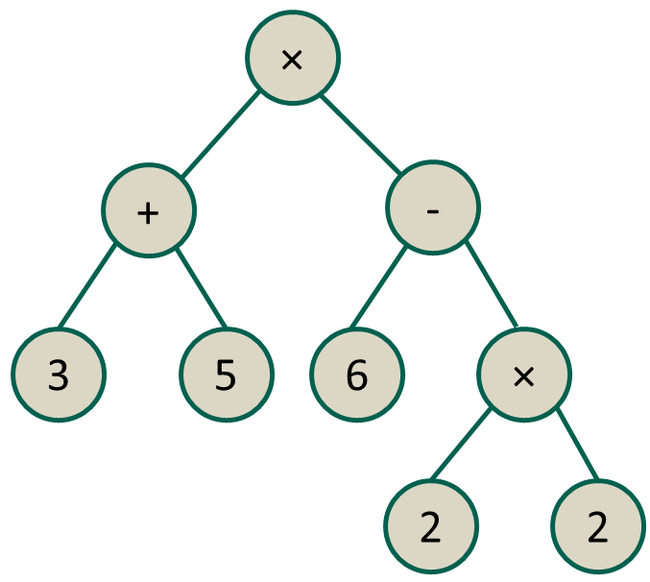
Mathematical Notation
Trees can be generated to express mathematical equations
The method by which you traverse the tree results in different formats for the equation. Given this tree:
Pre-fix notation: (× (+ 3 5) (- 6 (× 2 2)))
In-fix notation: ((3 + 5) × (6 - (2 × 2)))
Post-fix notation: ((3 5 +) (6 (2 2 ×) -) ×)
Post-fix is sometimes called Reverse
Polish Notation or RPN
(Invented in the 1920s by the Polish
mathematician Jan Lucasiewicz)

Slide 17
Binary Search Trees (BST)
Binary tree which is created using a specific process:
First element in the tree goes at the root
Next element is added by the following algorithm:
Start at the root
If the new element ≤ the element in the current node
Move to the left child
Else, if the new element > the element in the current node
Move to the right child
When you would move to a child that is empty
Create a new node with the current element at that child

Slide 18
Binary Search Trees (BST)
Binary tree which is created using a specific process:
First element in the tree goes at the root
Notice that the “equal” case can go either way
Start at the root
If the new element < the element in the current node
Move to the left child
Else, if the new element ≥ the element in the current node
Move to the right child
When you would move to a child that is empty
Create a new node with the current element at that child

Slide 19
Binary Search Trees (BST)
Search and traversal follows the same basic algorithm as adding elements
Finding the minimum element
Recursively move left until you reach a node with no left child
Finding the maximum element
Recursively move right until you reach a node with no right child
Traversal can be done in order

Slide 20
Binary Search Trees (BST) Example
Let’s do an example!
We’ll create and traverse the tree with the following elements
10
5
15
10
13
8
14
13

Slide 21
Binary Search Trees (BST)
Deletion can be trickier
If the node to be removed is a leaf, it can just be removed
Find the node’s parent and if the node to be deleted is the left or right child
Set that child to None
Set the to-be-deleted node’s parent to None

Slide 22
Binary Search Trees (BST)
Deletion can be trickier
If the node to be removed has one child
Find the node’s parent and if the node to be deleted is the left or right child
Find the node’s child
Set that child to the to-be-deleted node’s child
Set the parent of to-be-deleted node’s child’s node to the parent
Set the parent and child links of the to-be-deleted node to None

Slide 23
Binary Search Trees (BST)
Deletion can be trickier
If the node to be removed has two children
Find the in-order successor of the to-be-deleted node by finding the minimum element in the right subtree
Recursively move to the right child once
Recursively move to the left child until no left child exists
Swap the element of the to-be-deleted node with the element of the in-order successor
Delete the in-order successor node
This node will have 0 or 1 child, so follow that algorithm

Slide 24
Binary Search Tree Performance
BSTs generally perform no worse than linear counterparts
Accessing an element, inserting a new element, or deleting an element runs in O(log n) time.
Faster than arrays and sorted linked lists which run in O(n)
Slower than unsorted linked lists which run in O(1)
If the first element in the BST is very close to the minimum or maximum value to be inserted, the tree can be unbalanced
One subtree is SIGNIFICANTLY larger than the other
This can lead to a worst-case performance of O(n) on operations as the tree begins to resemble a sorted linked list

Slide 25
Questions?

